Slide 1




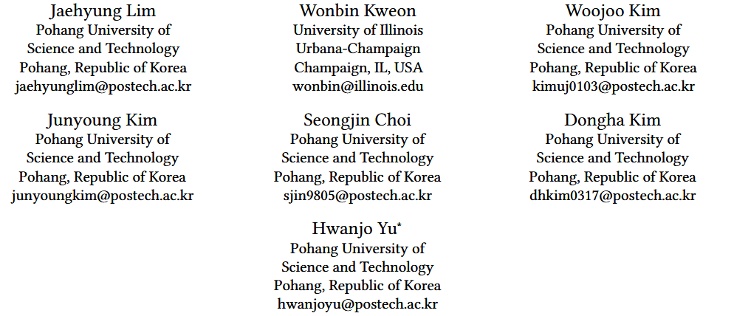





ATAI
Advanced Technique of Artificial Intelligence
ATAI
ChongqingUniversity _{AdvancedTechniqueof}
of Technology Artificial Intelligence
Chongqing University of
Technology
Chongqing University ^{ATAI}
_{of Technology} Advanced Techniqueof
Artificial Intelligence
Chongqing University of Technology
Chongqing University of Technology
Federated Continual Recommendation
https://github.com/Jaehyung-Lim/F3CRec-CIKM-25
——CIKM_2025
Reported by Jingbo Liu
1

Slide 2
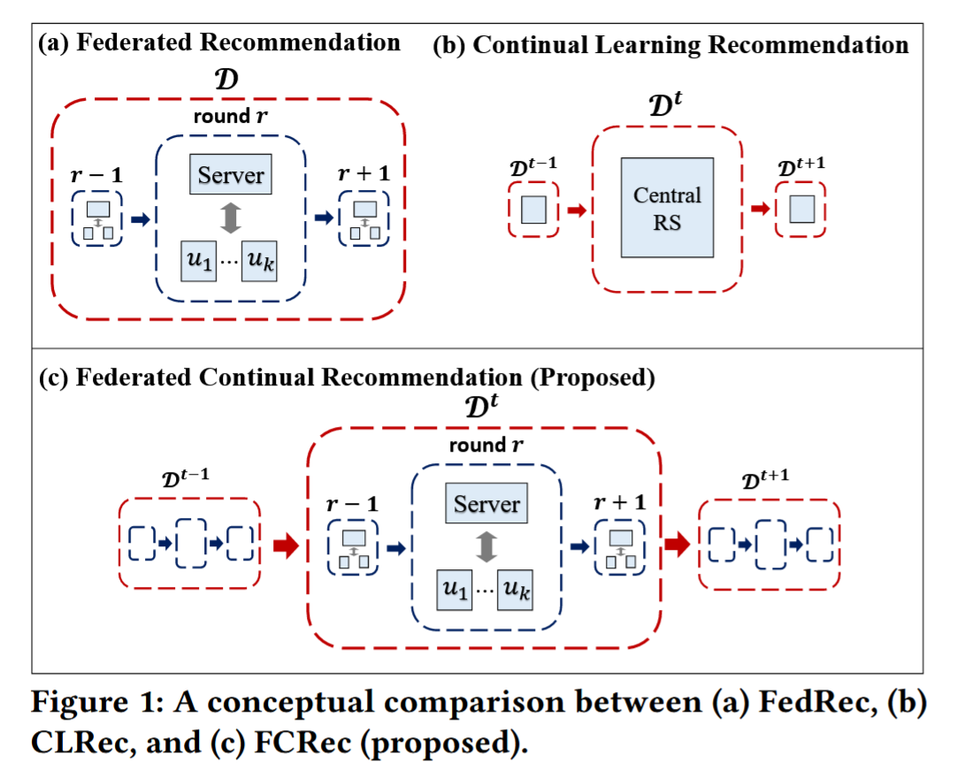
ATAI
Advanced Technique of Artificial Intelligence
ATAI
ChongqingUniversity _{AdvancedTechniqueof}
of Technology Artificial Intelligence
Chongqing University of
Technology
Chongqing University ^{ATAI}
_{of Technology} Advanced Techniqueof
Artificial Intelligence
Chongqing University of Technology
Chongqing University of Technology
Motivation
While Federated Recommendation (FedRec) effectively protects privacy, existing methods struggle with non-stationary data streams, failing to maintain consistent recommendation quality over time.
2) On the other hand, Continual Learning Recommendation (CLRec) methods address evolving user preferences but typically assume centralized data access, making them incompatible with FL constraints.

Slide 3
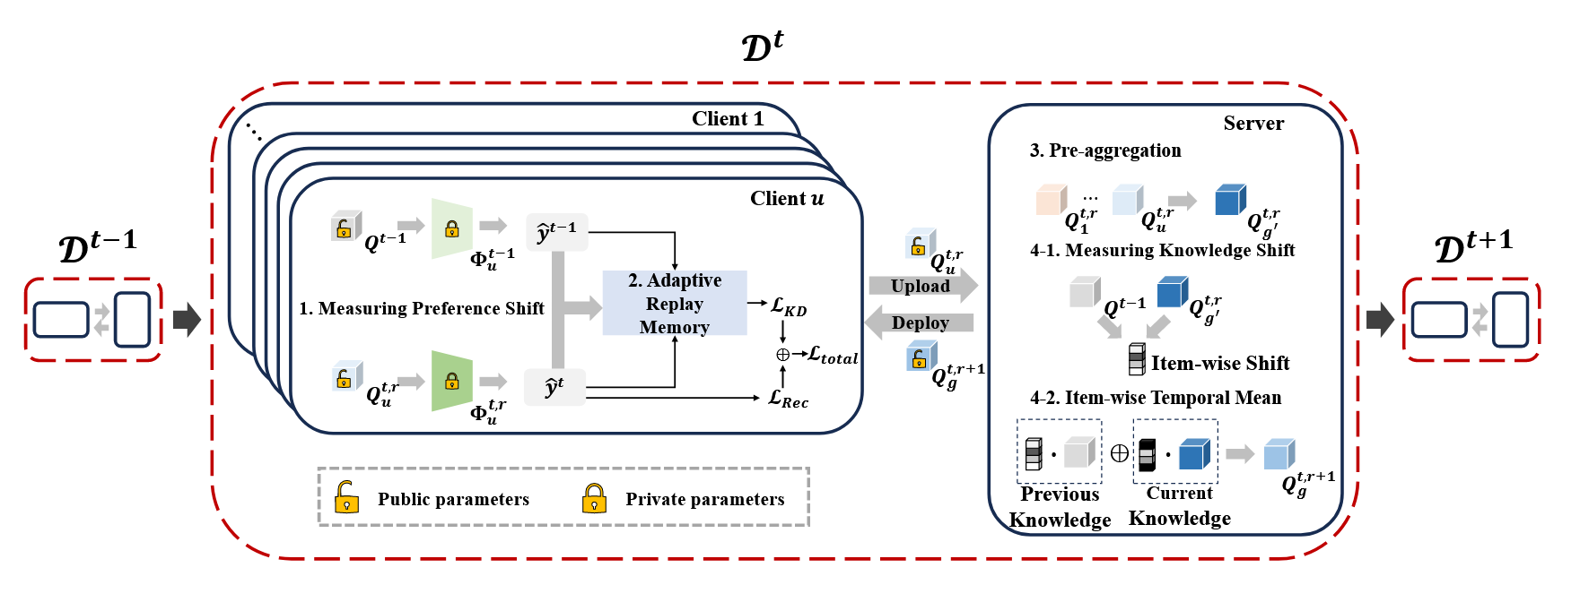
ATAI
ChongqingUniversity _{AdvancedTechniqueof}
of Technology Artificial Intelligence
Chongqing University of
Technology
ATAI
Advanced Technique of Artificial Intelligence
Chongqing University ^{ATAI}
_{of Technology} Advanced Techniqueof
Artificial Intelligence
Chongqing University of Technology
Chongqing University of Technology
Method

Slide 4
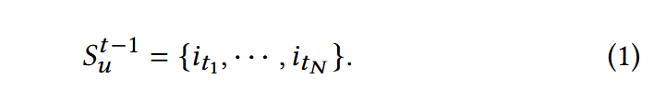
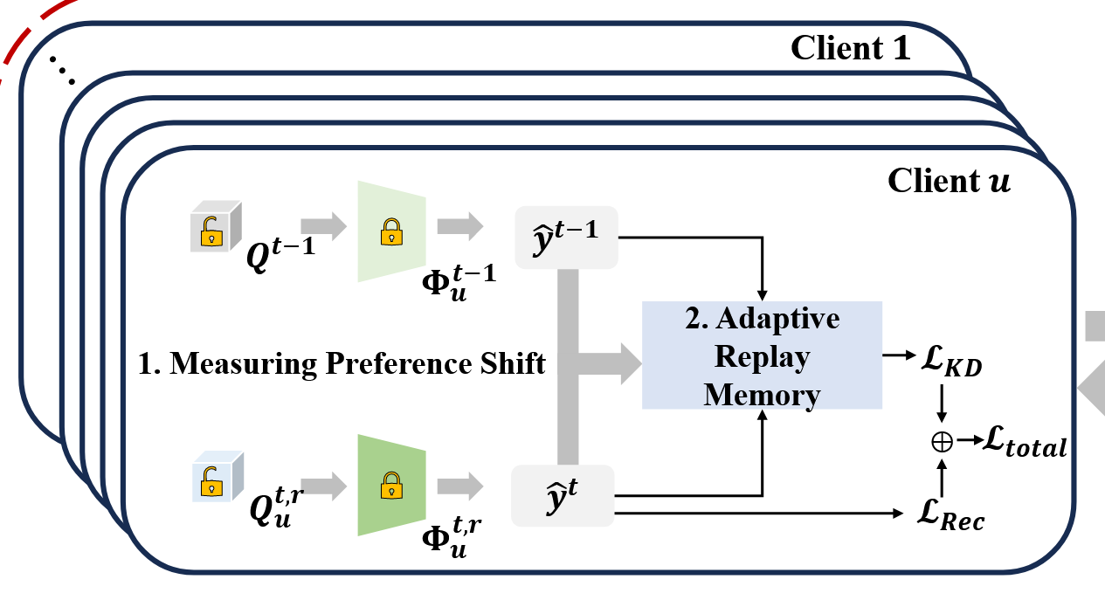
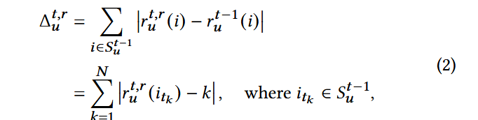

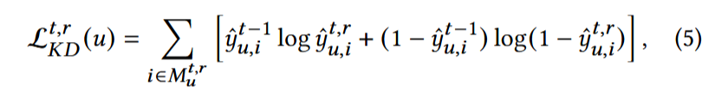

ATAI
Advanced Technique of Artificial Intelligence
ATAI
ChongqingUniversity _{AdvancedTechniqueof}
of Technology Artificial Intelligence
Chongqing University of
Technology
Chongqing University ^{ATAI}
_{of Technology} Advanced Techniqueof
Artificial Intelligence
Chongqing University of Technology
Chongqing University of Technology
Method

Slide 5
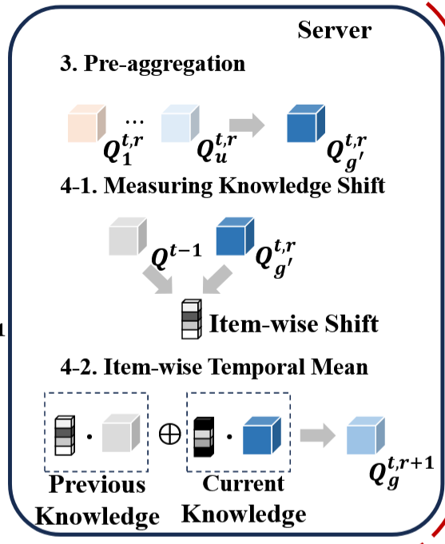


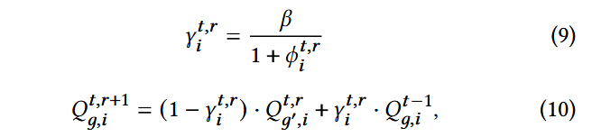

ATAI
Advanced Technique of Artificial Intelligence
ATAI
ChongqingUniversity _{AdvancedTechniqueof}
of Technology Artificial Intelligence
Chongqing University of
Technology
Chongqing University ^{ATAI}
_{of Technology} Advanced Techniqueof
Artificial Intelligence
Chongqing University of Technology
Chongqing University of Technology
Method

Slide 6
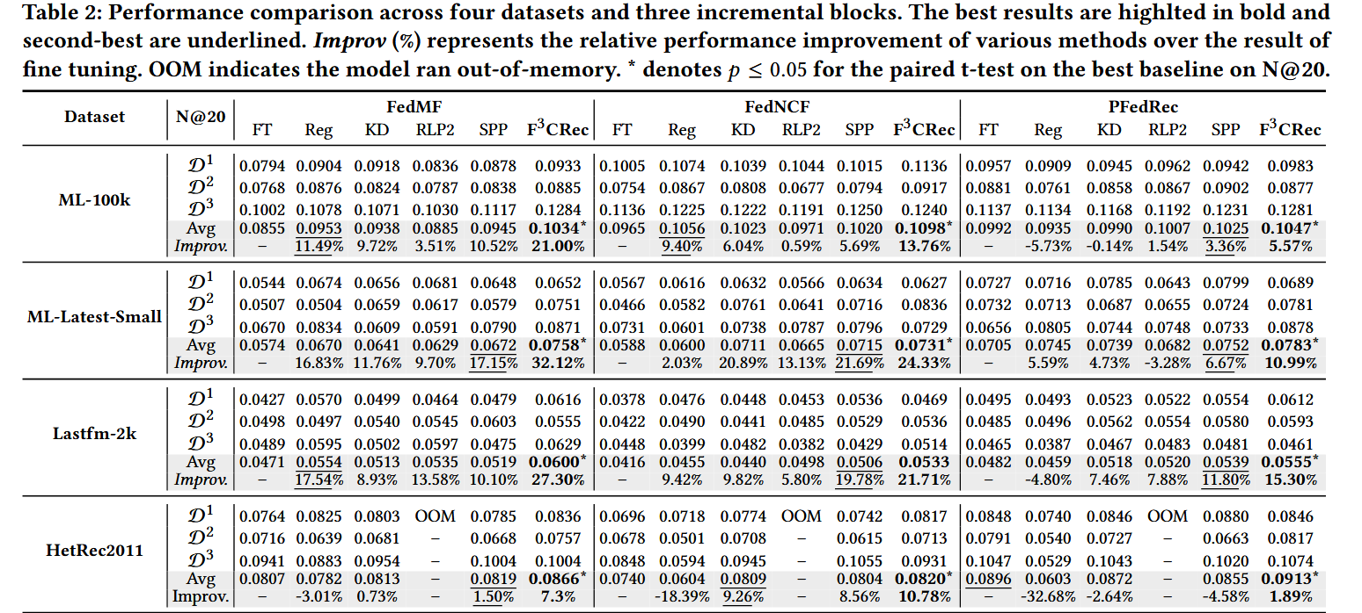
ATAI
Advanced Technique of Artificial Intelligence
ATAI
ChongqingUniversity _{AdvancedTechniqueof}
of Technology Artificial Intelligence
Chongqing University of
Technology
Chongqing University ^{ATAI}
_{of Technology} Advanced Techniqueof
Artificial Intelligence
Experiments
Chongqing University of Technology
Chongqing University of Technology

Slide 7
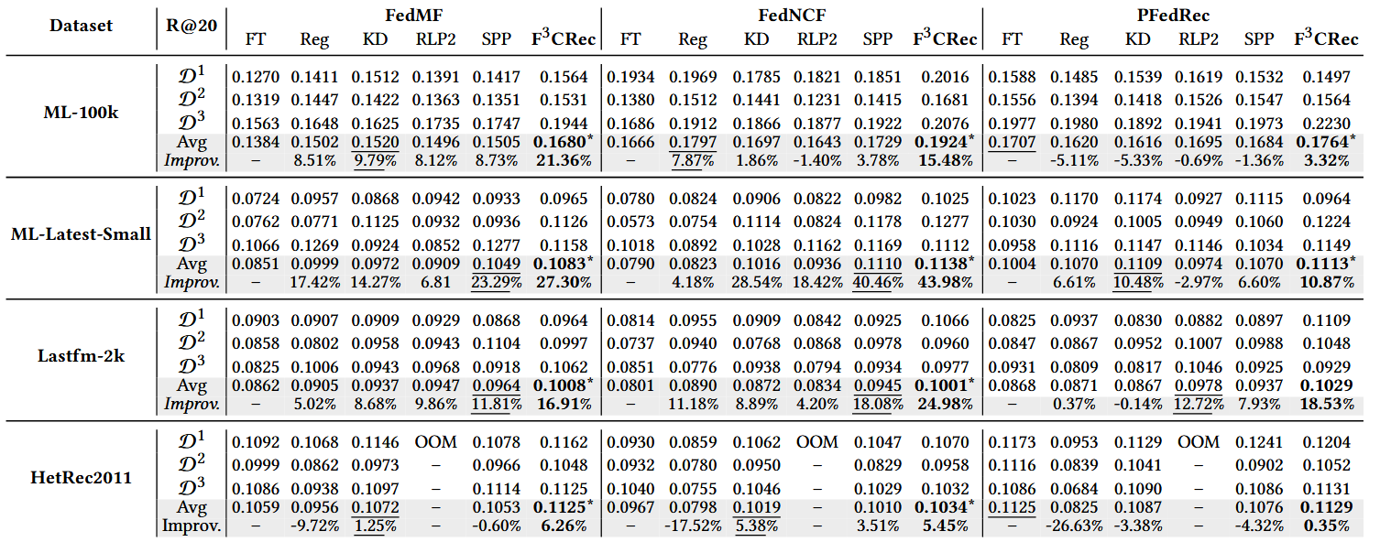
ATAI
Advanced Technique of Artificial Intelligence
ATAI
ChongqingUniversity _{AdvancedTechniqueof}
of Technology Artificial Intelligence
Chongqing University of
Technology
Chongqing University ^{ATAI}
_{of Technology} Advanced Techniqueof
Artificial Intelligence
Experiments
Chongqing University of Technology
Chongqing University of Technology

Slide 8
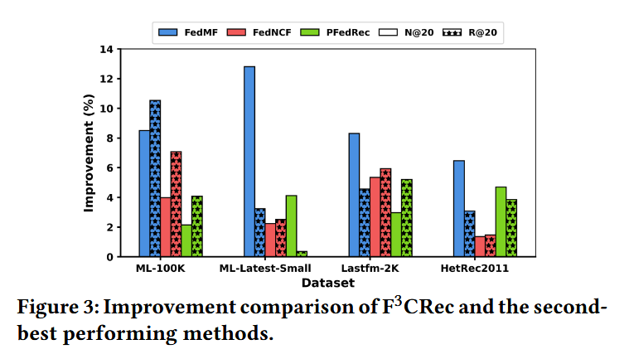
ATAI
Advanced Technique of Artificial Intelligence
ATAI
ChongqingUniversity _{AdvancedTechniqueof}
of Technology Artificial Intelligence
Chongqing University of
Technology
Chongqing University ^{ATAI}
_{of Technology} Advanced Techniqueof
Artificial Intelligence
Experiments
Chongqing University of Technology
Chongqing University of Technology

Slide 9
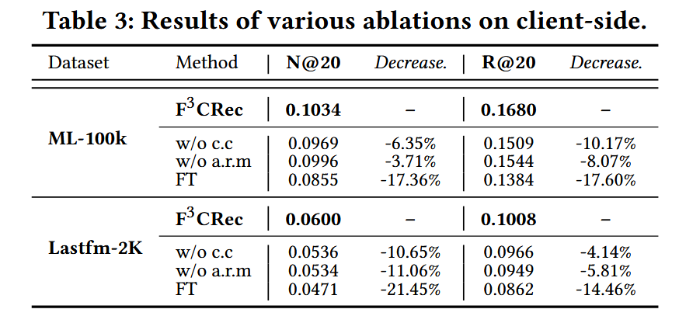
ATAI
Advanced Technique of Artificial Intelligence
ATAI
ChongqingUniversity _{AdvancedTechniqueof}
of Technology Artificial Intelligence
Chongqing University of
Technology
Chongqing University ^{ATAI}
_{of Technology} Advanced Techniqueof
Artificial Intelligence
Experiments
Chongqing University of Technology
Chongqing University of Technology

Slide 10
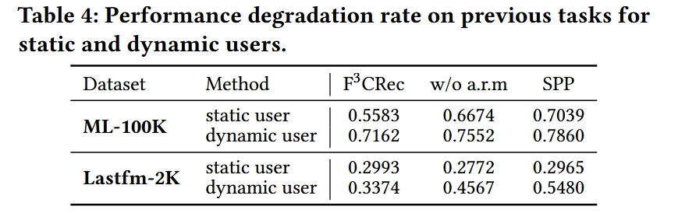
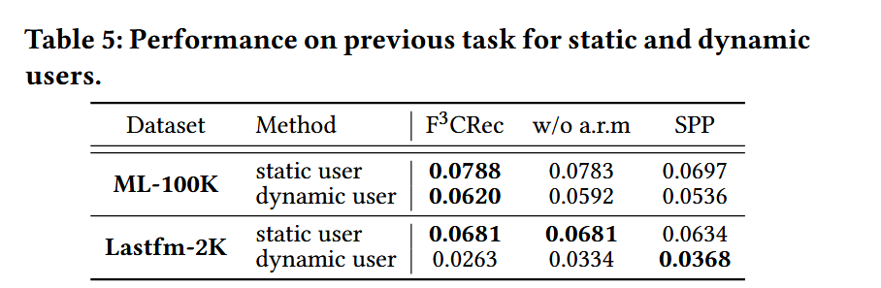
ATAI
Advanced Technique of Artificial Intelligence
ATAI
ChongqingUniversity _{AdvancedTechniqueof}
of Technology Artificial Intelligence
Chongqing University of
Technology
Chongqing University ^{ATAI}
_{of Technology} Advanced Techniqueof
Artificial Intelligence
Experiments
Chongqing University of Technology
Chongqing University of Technology

Slide 11
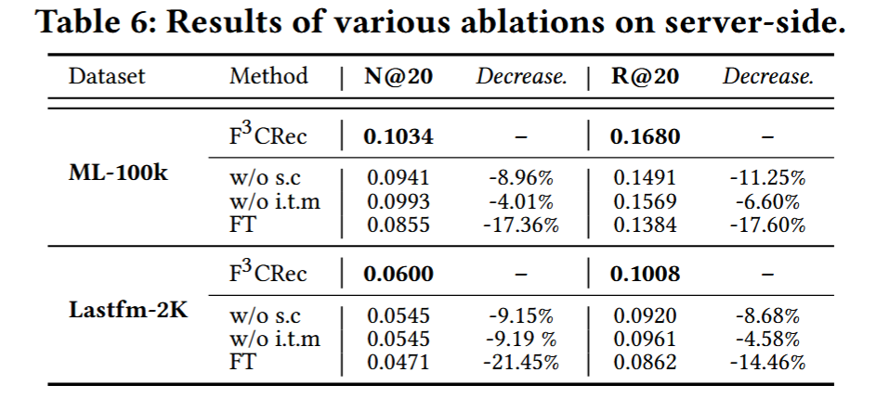
ATAI
Advanced Technique of Artificial Intelligence
ATAI
ChongqingUniversity _{AdvancedTechniqueof}
of Technology Artificial Intelligence
Chongqing University of
Technology
Chongqing University ^{ATAI}
_{of Technology} Advanced Techniqueof
Artificial Intelligence
Experiments
Chongqing University of Technology
Chongqing University of Technology

Slide 12
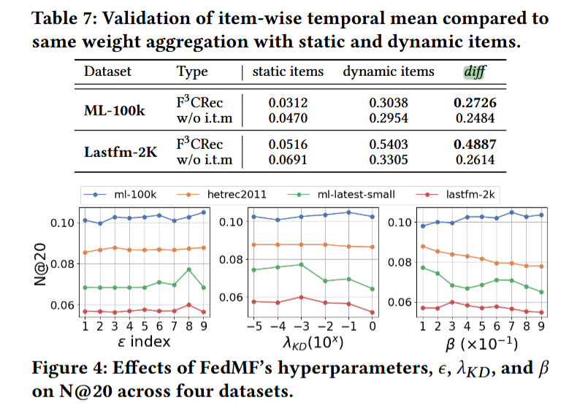
ATAI
Advanced Technique of Artificial Intelligence
ATAI
ChongqingUniversity _{AdvancedTechniqueof}
of Technology Artificial Intelligence
Chongqing University of
Technology
Chongqing University ^{ATAI}
_{of Technology} Advanced Techniqueof
Artificial Intelligence
Experiments
Chongqing University of Technology
Chongqing University of Technology

Slide 13
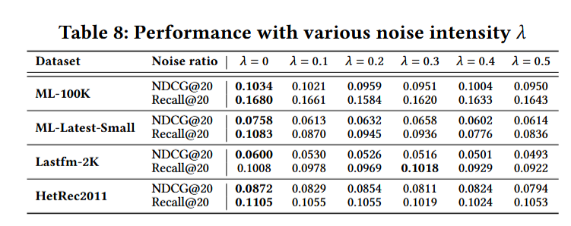
ATAI
Advanced Technique of Artificial Intelligence
ATAI
ChongqingUniversity _{AdvancedTechniqueof}
of Technology Artificial Intelligence
Chongqing University of
Technology
Chongqing University ^{ATAI}
_{of Technology} Advanced Techniqueof
Artificial Intelligence
Experiments
Chongqing University of Technology
Chongqing University of Technology

Slide 14


ATAI
Advanced Technique of Artificial Intelligence
ATAI
ChongqingUniversity _{AdvancedTechniqueof}
of Technology Artificial Intelligence
Chongqing University of
Technology
Chongqing University ^{ATAI}
_{of Technology} Advanced Techniqueof
Artificial Intelligence
Chongqing University of Technology
Chongqing University of Technology
Thanks!

